Slide 1
Vanguard’s Customer Experience
Federico Sarmiento Z.
José G. Portela

Slide 2
Context
Main question:
The digital world is evolving, and so are Vanguard’s clients. Vanguard believed that a more intuitive and modern User Interface (UI), coupled with timely in-context prompts (cues, messages, hints, or instructions provided to users directly within the context of their current task or action), could make the online process smoother for clients.
Would these changes encourage more clients to complete the process?

Slide 3
Data Overview
Data sets:
Client Profiles: Demographics like age, gender, and account details of our clients.
Digital Footprints: A detailed trace of client interactions online.
Experiment Roster: A list revealing which clients were part of the grand experiment.
Cleaning:
Client Profiles:
Drop 14 rows where at 7/9 column where without data.
Drop 575 rows where client age is less than tenure.
On gender column we assume the 3 clients with category call X as equivalent to category U.
Adjust data types for proper Tableau reading.
Digital Footprints:
concat part 1 and part2 to have one dataset
Drop duplicate
Experiment Roster:
Adjust data types for proper Tableau reading.

Slide 4
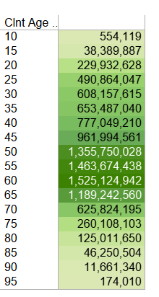
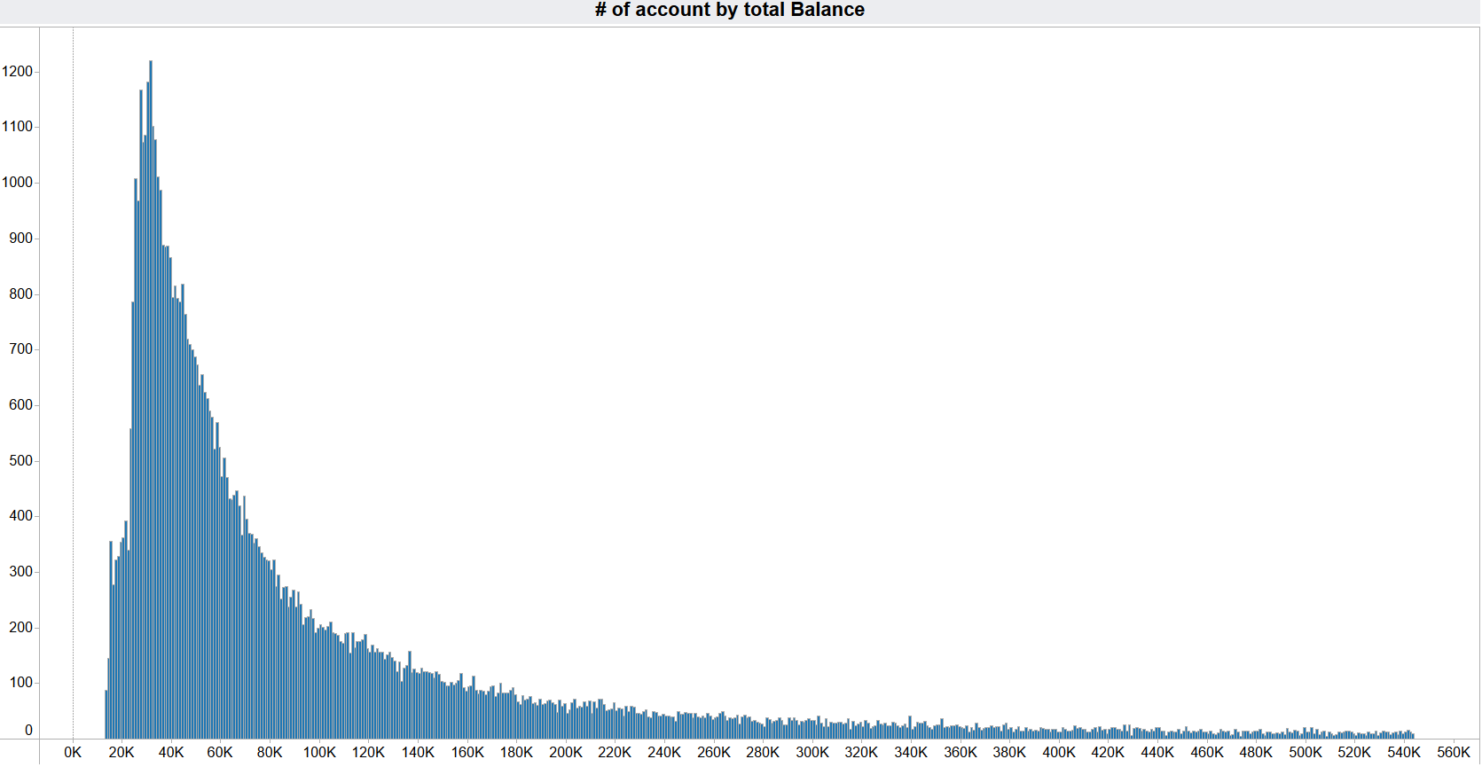

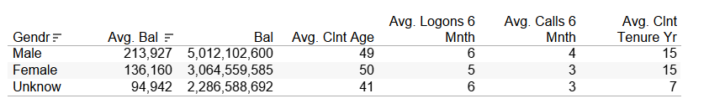

Exploratory Data Analysis
The clean base has 70,020 clients from which 50,156 (72%) participated in the experiments
Key demographic and behaviours:
The primary client is an individual, whether male or female, holding more than 2 open accounts with an average balance of $148K. They are between 21 and 70 years old, have maintained an account for a duration spanning 6 to 25 years, and, on average, use the portal or call 1.5 times every month.
Finding:
The balance range is between 13K to 16M and primarily concentrated on clients aged between 40 and 70.
All clients log in once every 6 months, and almost none of them have only one account.
The Unknown group is younger, less wealthy and with shorter average duration using Vanguard.

Slide 5
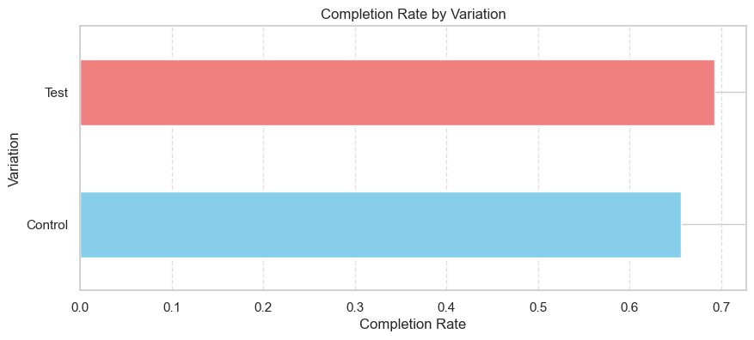
Performance Metrics
Key performance indicators (KPIs):
Completion Rate
Time Spent on Each Step
Error Rates

Slide 6
Performance Metrics
Results:
Completion Rates:
'Control' variation: ~65.59% (0.655873)
'Test' variation: ~69.29% (0.692932)
Overall Comparison:
The 'Test' variation has a slightly higher completion rate than the 'Control' variation.
Analysis of Time Spent:
The 'Test' variation generally exhibits higher average time spent on each step compared to the 'Control' variation.

Slide 7
Performance Metrics
Results:
Error Rates:
For both 'Control' and 'Test' variations, error rates were NaN (Not a Number) values.
Potential reasons:
No recorded errors in the dataset.
The need for adjustment in error rate calculation criteria.

Slide 8
Hypothesis Testing: Completion Rate
Standard error was calculated before hand.
Two-sample z-test
Hypothesis:
Null Hypothesis (Ho): There is no significant difference in completion rates.
Alternative Hypothesis (Ha): There is a significant difference in completion rates
Results:
Control and Test Completion Rate: 0.12201837420362187 ≈ 12.20% and 0.1446299347191687 ≈ 14.46%
Z-statistic: -18.67324116863663
P-value: 8.173840595991908e-78
Conclusion:
We reject the null hypothesis, indicating that there is a statistically significant difference in completion rates between the 'Control' and 'Test' variations.

Slide 9
Completion Rate with Cost-Effectiveness Threshold
A One sample z-test with a threshold of 0.05 (5%)
Hypothesis:
Null Hypothesis (Ho): The observed increase does not meet or exceeds the 5% threshold.
Alternative Hypothesis (Ha): The observed increase meets or exceeds the 5% threshold.
Results:
Observed Completion Rate Increase: 0.022611560515546844
Z-statistic: -123.56432809551994
P-value: 1.0
Conclusion: The observed increase in completion rate is not statistically significant, and it does not meet the specified 5.0% threshold for cost-effectiveness.

Slide 10
Hypothesis Testing: Average Age of Clients
Two sample t-test
Hypothesis:
Null Hypothesis (Ho): There is no significant difference in average age.
Alternative Hypothesis (Ha): There is a significant difference in average age.
Results:
Average Age (Control): 48.30989554278701
Average Age (Test): 48.75001828030171
T-statistic: -7.926400435419626
P-value: 2.263054043650787e-15
Conclusion: There is a significant difference in average age.

Slide 11
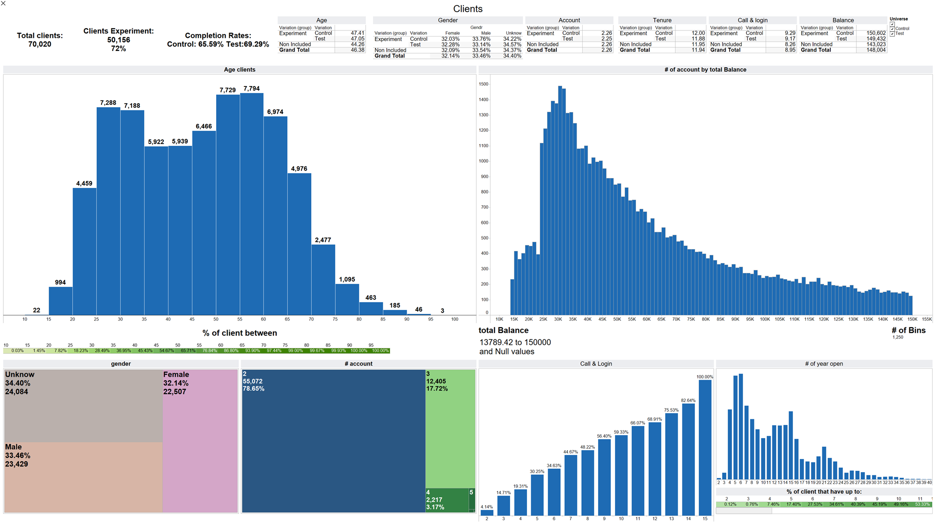
Tableau Visualization

Slide 12
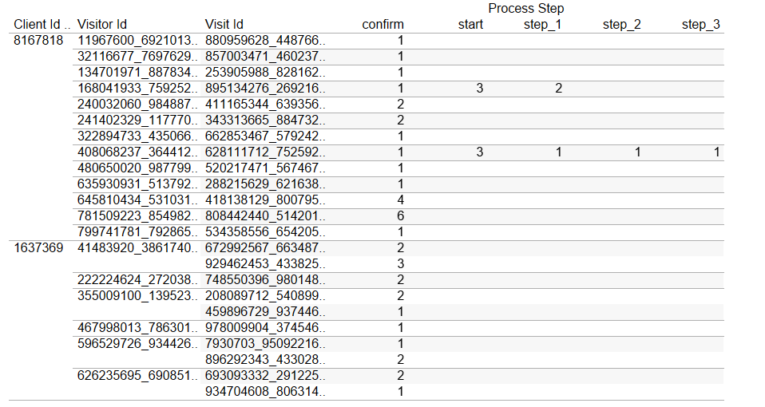
Challenges and Learnings
Dataset inconsistency:
Technical challenge Tableau and calculation of the KPI.

Slide 13
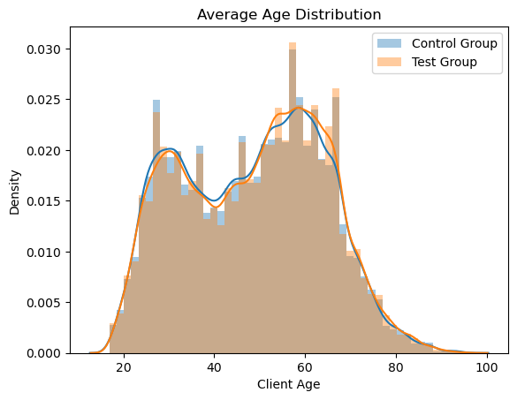
Challenges and Learnings
Analysis Results:
Test results indicated differences between the variations.
Upon visual inspection, no noticeable difference was observed.

Slide 14
Conclusions:
Consider user feedback or usability testing to identify specific areas for enhancement.
Consider the overall impact on user engagement, revenue, and other relevant metrics to assess whether the redesign justifies the associated costs.
Assess the long-term impact of the redesign by extending the observation period or conducting follow-up analyses.

Slide 15


